Slide 1
Predicate Logic

Slide 2
Propositional Logic
Language of logic is one particular way of representing facts.
It suggests a powerful way of deriving new knowledge from old, known as mathematical deduction
Representing simple facts
It is raining
RAINING
It is sunny
SUNNY
It is windy
WINDY
If it is raining, then it is not sunny
RAINING → ¬SUNNY

Slide 3
Using Propositional Logic
  Theorem proving is decidable
  Cannot represent objects and quantification

Slide 4
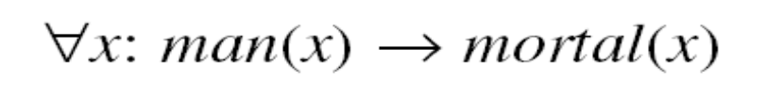
Limitations of Propositional Logic
Socrates is a man.
SOCRATESMAN
Plato is a man.
PLATOMAN
Better representations :
MAN(SOCRATES)
MAN(PLATO)
All men are mortal.

Slide 5
Using Predicate Logic
  Can represent objects and quantification
  Theorem proving is semi-decidable
  Despite the theoretical undecidability of predicate logic, it can still serve as a useful way of representing and manipulating some of the kinds of knowledge

Slide 6
Using Predicate Logic
Consider the following set of statements:
Marcus was a man.
2. Marcus was a Pompeian.
3. All Pompeian were Romans.
4. Caesar was a ruler.
All Pompeian were either loyal to Caesar or hated him.
6. Every one is loyal to someone.
People only try to assassinate rulers they are not loyal to.
Marcus tried to assassinate Caesar.

Slide 7
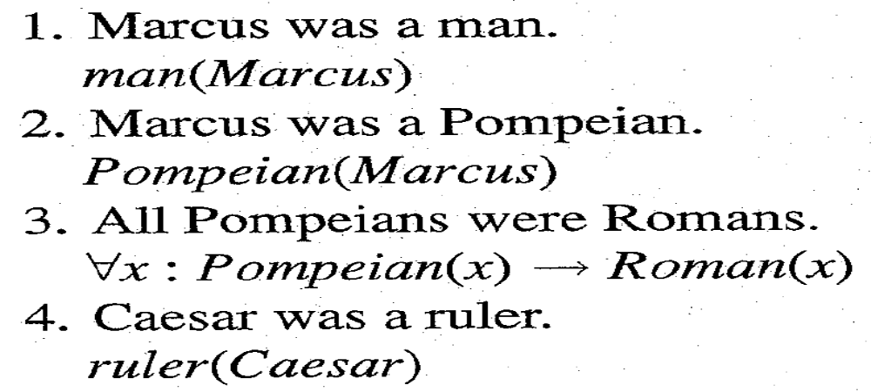
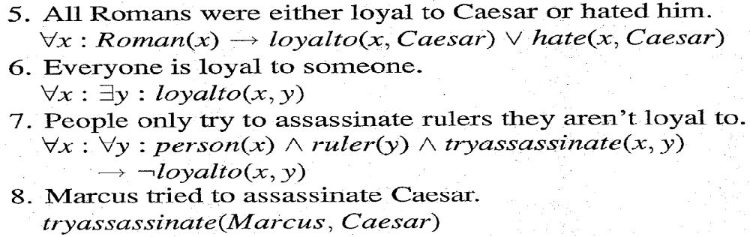
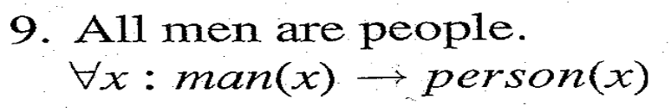
A Predicate Logic Example

Slide 8
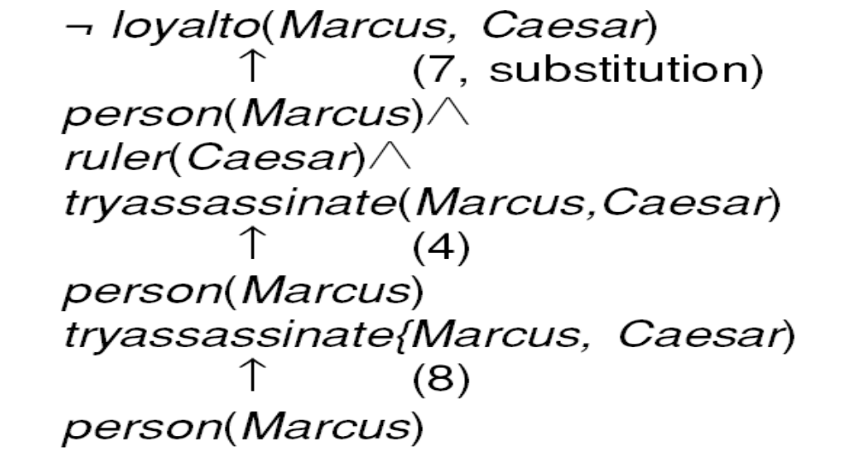





An Attempt to Prove

Slide 9
Using Predicate Logic
Many English sentences are ambiguous.
There is often a choice of how to represent knowledge.
Obvious information may be necessary for reasoning
We may not know in advance which statements to deduce (P or ¬P).

Slide 10
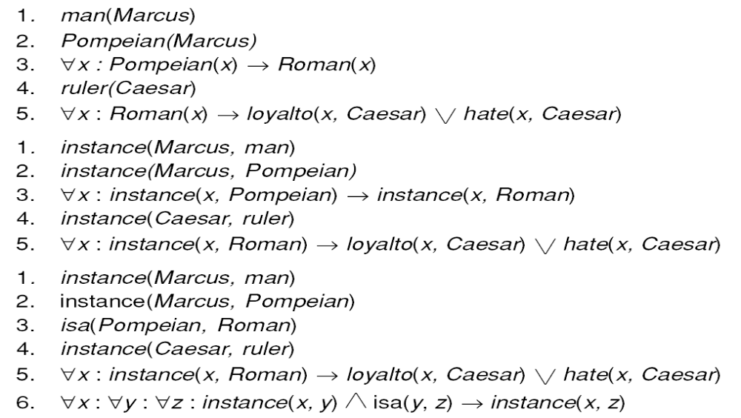
Three Ways of Representing
Class Membership

Slide 11
COMPUTABLE FUNCTIONS AND PREDICATES
  All the simple facts were expressed as combinations of individual predicates, such as:
tryassasinate(Marcus, Caesar)
  But suppose we want to express simple facts, such as the following greater-than and less-than relationships:
gt(1,0) It(0,1)
gt(2,1) It(1,2)
gt(3,2) It( 2,3)
we do not want to have to write out the representation of each of these facts individually. For one thing, there are infinitely many of them.

Slide 12
COMPUTABLE FUNCTIONS AND PREDICATES
It would be extremely inefficient to store explicitly a large set of statements. we could easily compute each one as we need it.
Thus it becomes useful to augment our representation by computable predicates. Whatever proof procedure we use, when it comes upon one of these predicates, instead of searching for it explicitly in the database or attempting to deduce it by further reasoning, we can simply invoke a procedure, which we will specify in addition to our regular rules, that will evaluate it and return true or false.
It is often also useful to have computable functions as well as computable predicates. Thus we might want to be able to evaluate the truth of
gt(2 + 3,1)

Slide 13
Another Predicate Logic Example
Marcus was a man.
Marcus was a Pompeian.
Marcus was born in 40 A.D.
All men are mortal.
All Pompeians died when the volcano erupted in 79 A.D.
No mortal lives longer than 150 years.
It is now 1991.
Alive means not dead.
If someone dies, then he is dead at all later times.

Slide 14
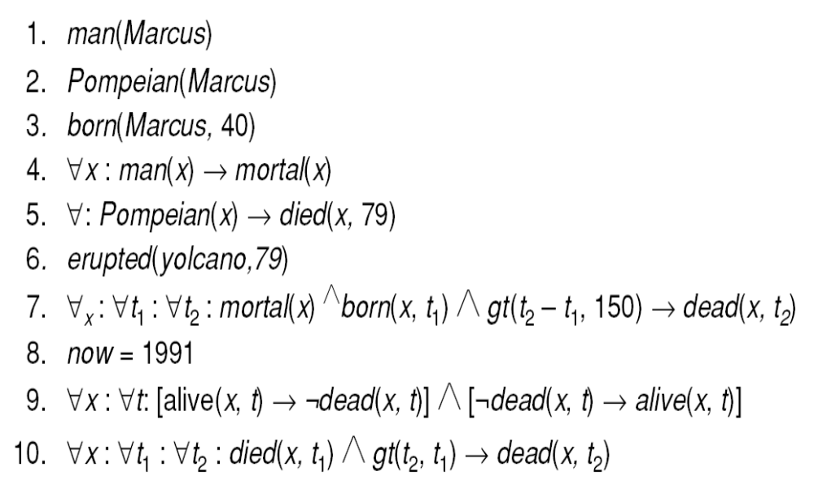
A Set of Facts about Marcus

Slide 15
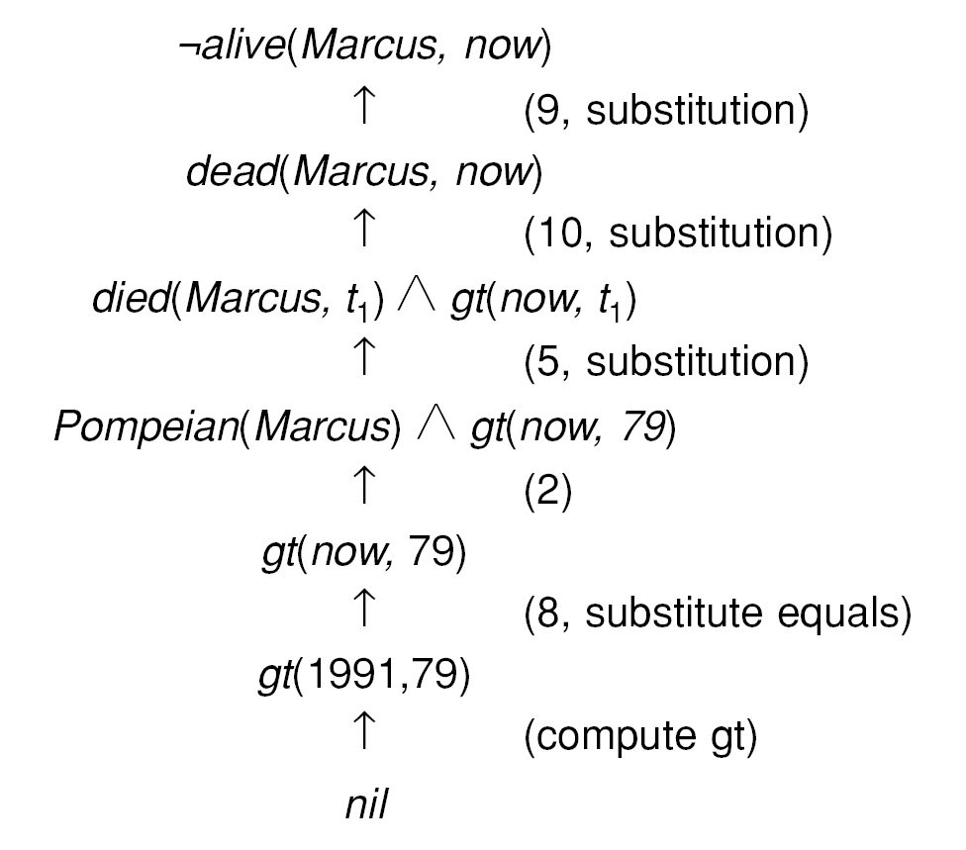
One Way of Proving That Marcus Is Dead

Slide 16
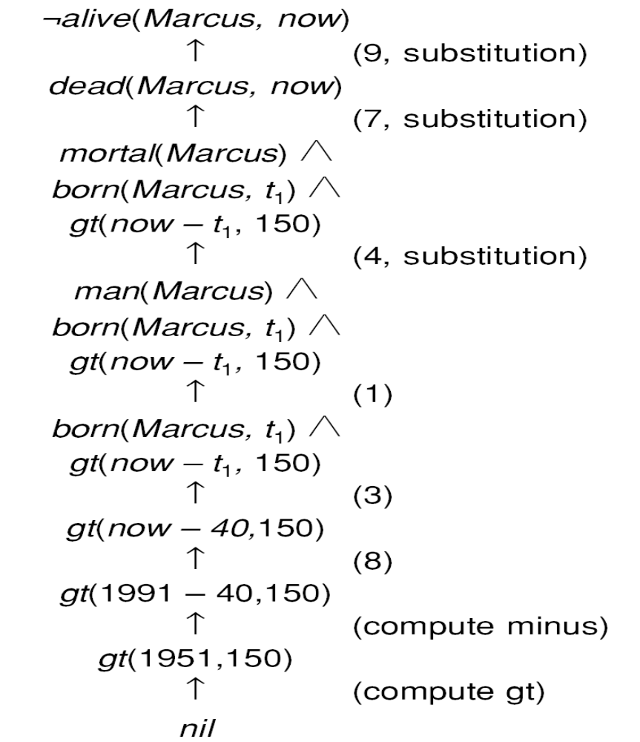
Another Way of Proving That Marcus Is Dead

Slide 17
Resolution
Resolution produces proofs by refutation.
To prove a statement (i.e., show that it is valid), resolution attempts to show that the negation of the statement produces a contradiction with the known statements (i.e. , that it is unsatisfiable).
This approach contrasts with the technique that we have been using to generate proofs by chaining backward from the theorem to be proved to the axioms.
To apply resolution we have to represent the statements in the standard form.
We need to convert the statements in the clause form.

Slide 18
Conversion to Clause form
Suppose we know that “all Romans who know Marcus either hate Caesar or think that anyone who hates anyone is crazy”.
We could represent that in the following wff:
∀x: [Roman(x) ∧ know(x, Marcus)] →
[hate(x, Caesar) V (∀y : ∃z : hate (y, z) → thinkcrazy(x, y))]
To use this formula in a proof requires a complex matching process.
If the formula were in a simpler form, this process would be much easier.

Slide 19
Conversion to Clause form
The formula would be easier to work with if
• It were flatter, i.e., there was less embedding of components .
• The quantifiers were separated from the rest of the formula so that they did not need to be considered.
Conjunctive normal form [Davis and Putnam, 1960] has both of these properties.
For example, the formula given above for the feelings of Romans who know Marcus would be represented in conjunctive normal form as
¬ Roman(x) ∧ ¬ know(x, Marcus) V
hate(x, Caesar) V ¬ hate(y, z) V thinkcrazy(x, z)

Slide 20


Conversion to Clause Form
Problem :
Solution :
 Flatten
 Separate out Quantifiers
Conjunctive Normal Form :
Clause Form :
 Conjunctive Normal Form
 No instances of

Slide 21
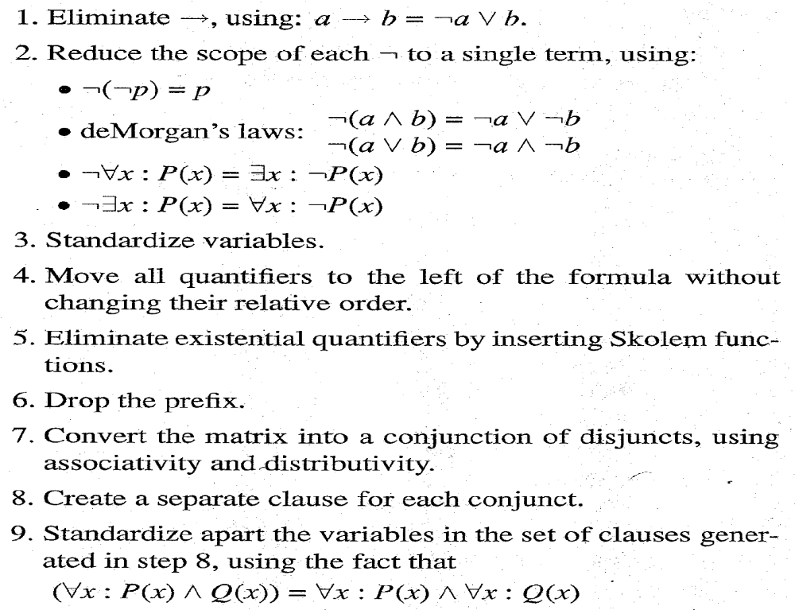
Algorithm : Convert to Clause Form

Slide 22
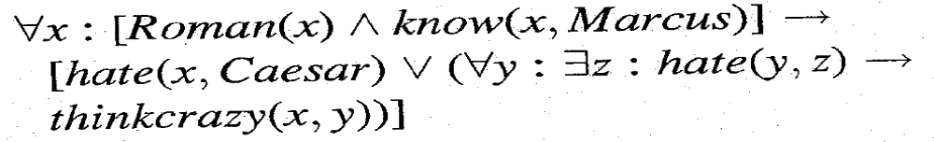


Examples of Conversion to Clause Form
Example :
1 Eliminate 
2 Reduce scope of
3 Standardize Variables.

Slide 23
3. Standardize variables
Standardize variables so that each quantifier binds a unique variable.
Since variables are just dummy names, this process cannot affect the truth value of the wff. For example, the formula
∀x: P(x) V ∀x: Q(x)
would be converted to
∀x: P(x) V ∀y: Q(y)
This step is in preparation for the next.

Slide 24
4. Move all quantifiers to the left of the formula
Move all quantifiers to the left of the formula without changing their relative order.
This is possible since there is no conflict among variable names.
Performing this operation on the formula of step 2, we get
∀x: ∀y: ∀ z: [¬ Roman(x) V ¬ know(x, Marcus)] V
[hate(x, Caesar) V (¬ hale(y, z) V thinkcrazy(x, y))]
At this point, the formula is in what is known as prenex normal form. It consists of a prefix of quantifiers followed by a matrix, which is quantifier-free.

Slide 25
5. Eliminate existential quantifiers
We can eliminate the quantifier by substituting for the variable a reference to a function that produces the desired value. So, for example, the formula
∃y : President(y)
can be transformed into the formula
President(S1)
where S1 is a function with no arguments that produces a value that satisfies President. If existential quantifiers occur within the scope of universal quantifiers, then the value that satisfies the predicate may depend on the values of the universally quantified variables.

Slide 26





Examples of Conversion to Clause Form
4 Move quantifiers.
5 Eliminate existential quantifiers.
will be converted to
while
will be converted to
6 Drop the prefix.
7 Convert to a conjunction of disjuncts.

Slide 27
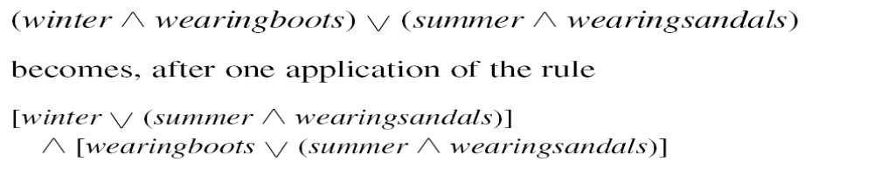
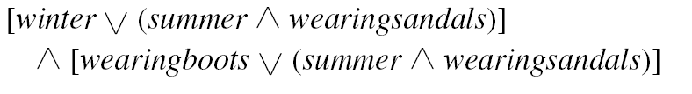
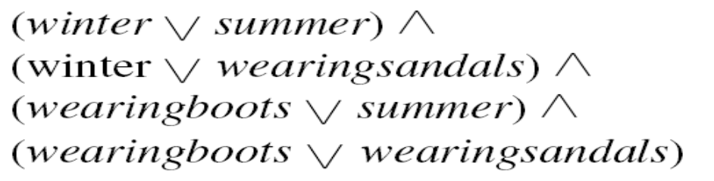
Examples of Conversion to Clause Form
The Formula
becomes
and then becomes

Slide 28
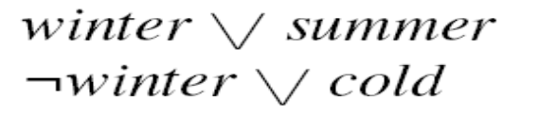

The Basis of Resolution
Given :
becomes

Slide 29
Algorithm : Propositional Resolution
Convert all the propositions of F to clause form.
2. Negate P and convert the result to clause form. Add it to the set of clauses obtained in step 1.
3. Repeat until either a contradiction is found or no progress can be made:
Select two clauses. Call these the parent clauses.
(b) Resolve them together. The resulting clause, called the resolvent, will be the disjunction of all of the literals of both of the parent clauses with the following exception: If there are any pairs of literals L and ¬L such that one of the parent clauses contains L and the other contains ¬L, then select one such pair and eliminate both L and ¬L from the resolvent.
(c) If the resolvent is the empty clause, then a contradiction has been found. If it is not, then add it to the set of clauses available to the procedure.

Slide 30
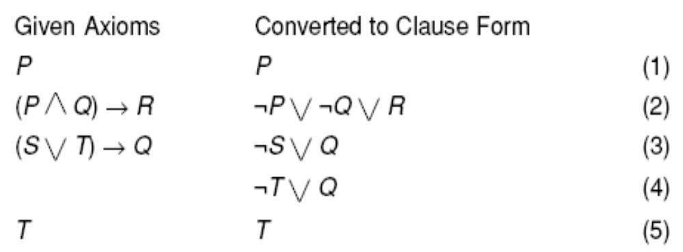
A Few Facts in Propositional Logic

Slide 31
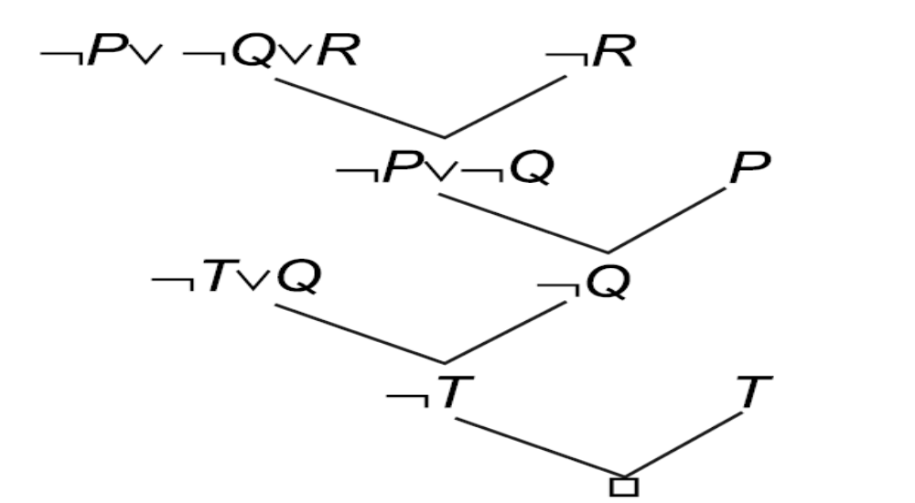
Resolution in Propositional Logic

Slide 32
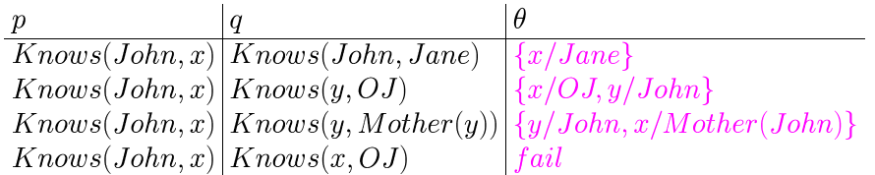
Unification

Slide 33
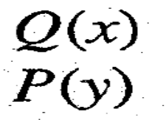

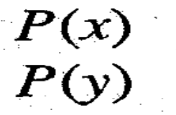

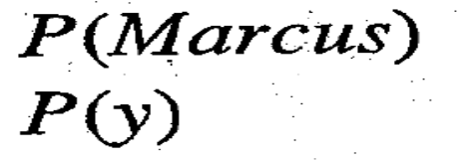

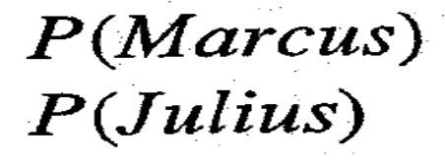
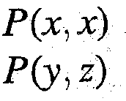
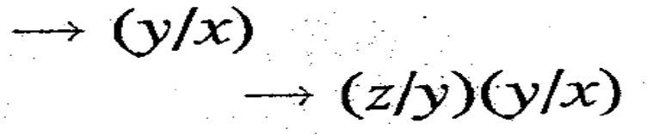

Unification

Slide 34
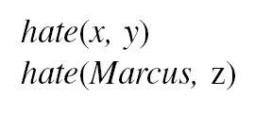
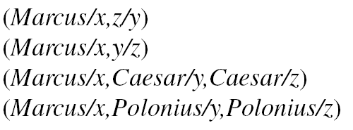
Finding General Substitutions
Given :
We could produce :
The first two of these are equivalent except for lexical variation.
But the second two, although they produce a match, also produce a substitution that is more restrictive than absolutely necessary for the match.
Because the final substitution produced by the unification process will be used by the resolution procedure, it is useful to generate the most general unifier possible.

Slide 35
Finding General Substitutions
The algorithm Unify(L1, L2) will do that.
  Procedure Unify(L1, L2) returns a list representing the composition of the substitutions that were performed during the match.
  The empty list NIL, indicates that a match was found without any substitutions.
  The list consisting of the single value FAIL indicates that the unification procedure failed.

Slide 36
Algorithm : Unify (L1, L2)
If L1 or L2 are both variables or constants, then:
(a) If L1 and L2 are identical, then return NIL.
(b) Else if L1 is a variable, then if L1 occurs in L2 then return {FAIL}, else return (L2/L1).
(c) Else if L2 is a variable then if L2 occurs in L1 then return {FAIL}, else return (L1/L2).
(d) Else return {FAIL}.
2. If the initial predicate symbols in L1 and L2 are not identical, then return {FAIL).
3. If LI and L2 have a different number of arguments, then return {FAIL}.
4. Set SUBST to NIL.
5. For i ← 1 to number of arguments in L1:
(a) Call Unify with the ith argument of L1 and the ith argument of L2, putting result in S.
(b) If S contains FAIL then return {FAIL}.
(c) If S is not equal to NIL then:
(i) Apply S to the remainder of both L1 and L2.
(ii) SUBST : = APPEND(S, SUBST).
6. Return SUBST.

Slide 37
Algorithm : Resolution
Assuming there are set of statements F and a statement to be proved is P:
1. Convert all the statements of F to clause form.
2. Negate P and convert the result to clause form. Add it to the set of clauses obtained in 1.
3. Repeat until either a contradiction is found, no progress can be made, or a predetermined amount of effort has been expended.
Select two clauses. Call these the parent clauses.
Resolve them together. The resolvent will be the disjunction of all the literals of both parent clauses with appropriate substitutions performed and with the following exception: If there is one pair of literals T1 and ¬T2 such that one of the parent clauses contains T2 and the other contains T1 and if T1 and T2 are unifiable, then neither T1 nor T2 should appear in the resolvent. If there is more than one pair of complimentary literals, only one pair should be omitted from the resolvent.
If the resolvent is the empty clause, then a contradiction has been found. If it is not, then add it to the set of clauses available to the procedure.

Slide 38
A Set of Facts about Marcus

Slide 39
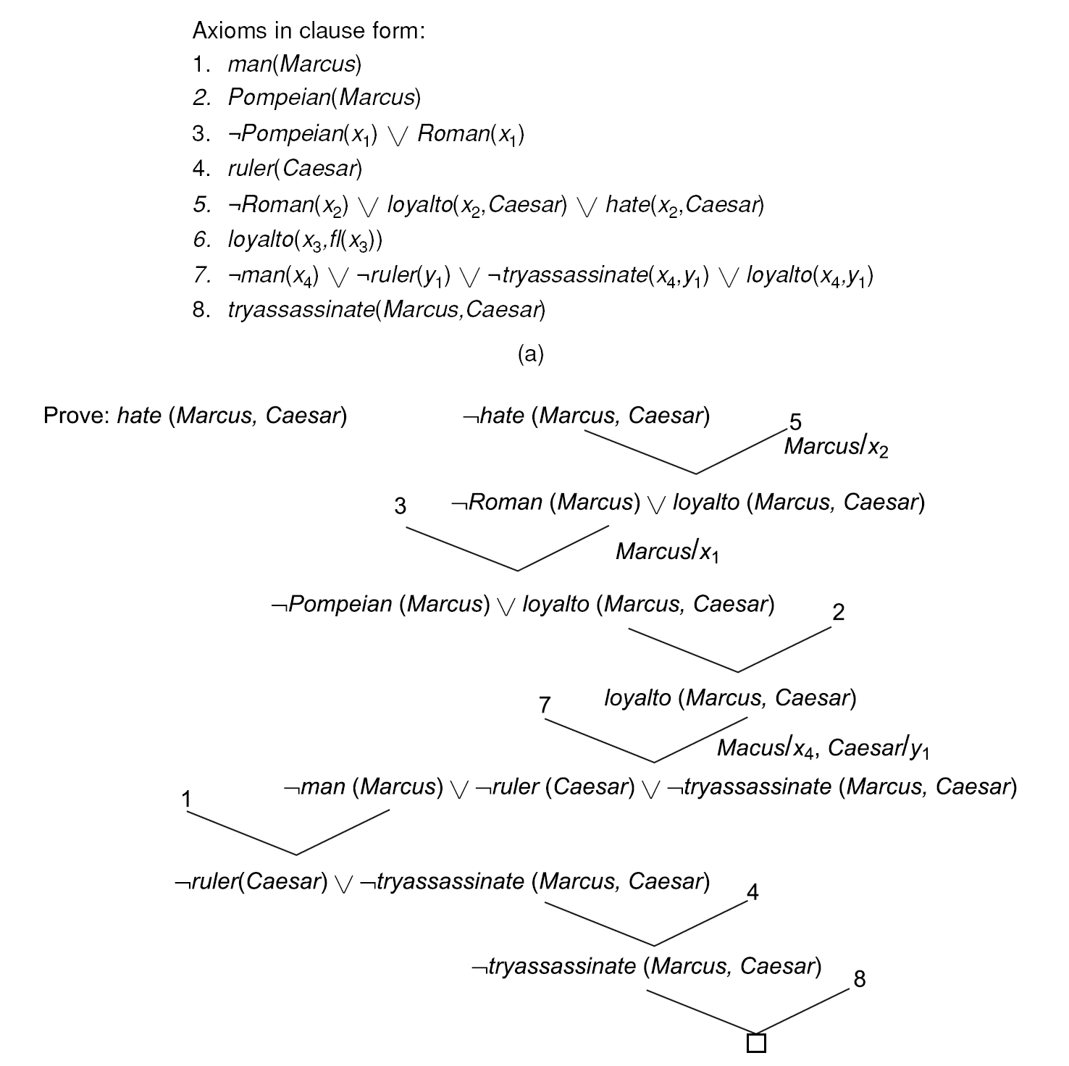
A Resolution Proof

Slide 40
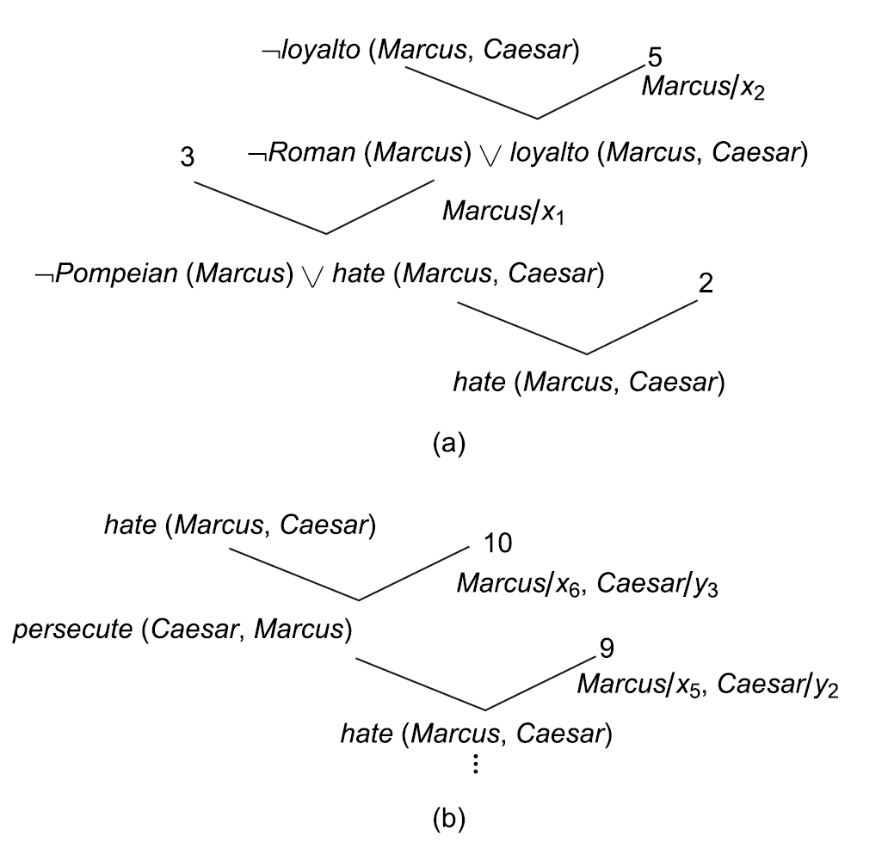
An Unsuccessful Attempt at Resolution

Slide 41
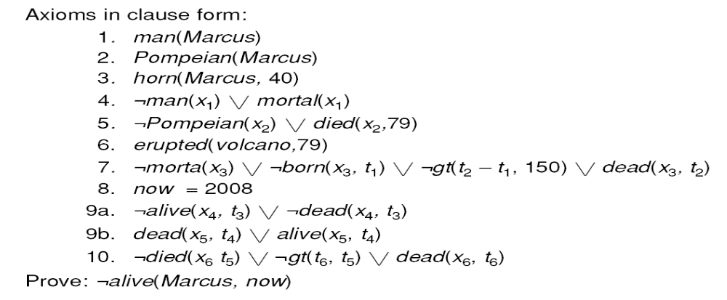
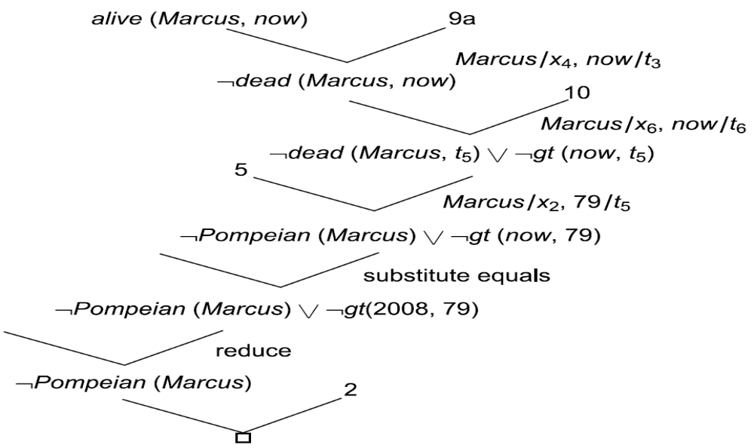
Using Resolution with Equality and Reduce

Slide 42
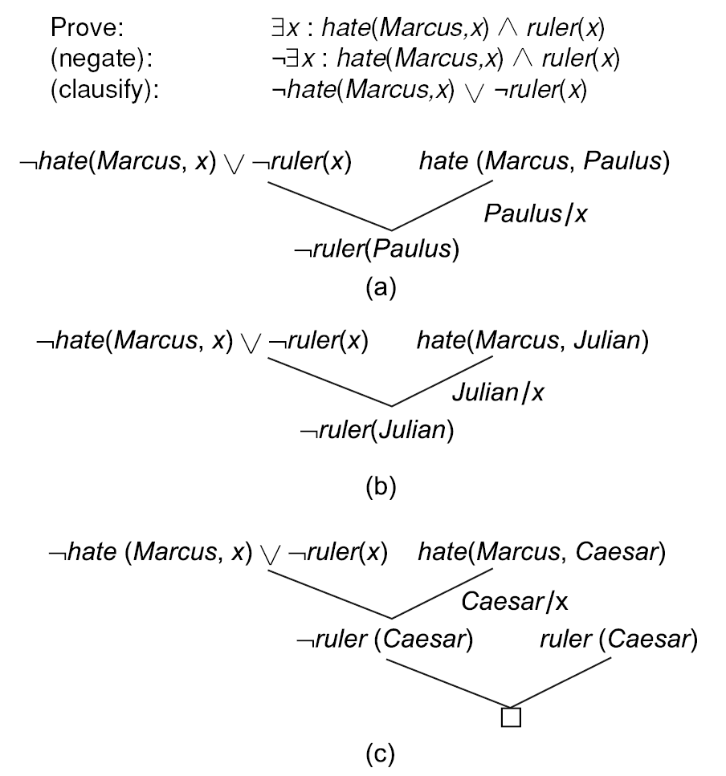
Trying Several Substitutions

Slide 43
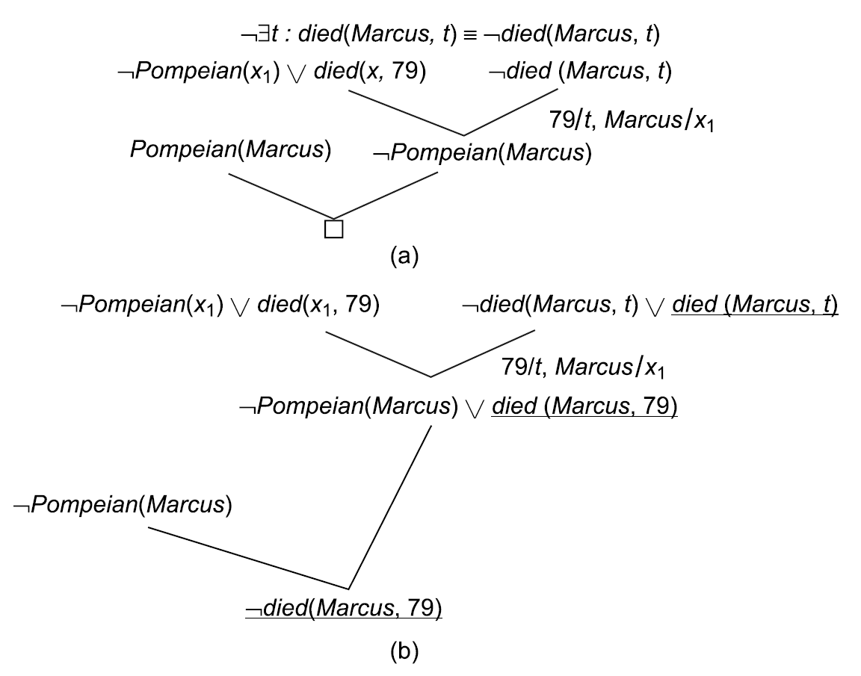
Answers Extraction Using Resolution

Slide 44

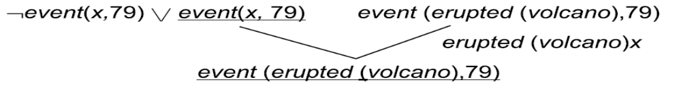
The Need to Change Representations
“What happened in 79 A.D.?”
But we have
erupted(volcano, 79)

Slide 45
Resolution Example
John likes all kind of food.
Apples are food.
Chicken is food.
Anything anyone eats and isn’t killed by is food.
Bill eats peanuts and is still alive.
Sue eats everything Bill eats.

Slide 46
Resolution Example
The members of the Elm St. Bridge Club are Joe, Sally, Bill and Ellen.
Joe is married to Sally.
Bill is Ellen’s brother.
The spouse of every married person in the club is also in the club.
The last meeting of the club was at Joe’s house.

Slide 47
Resolution Example
Steve only likes easy courses.
Science courses are hard.
All the courses in the basket weaving department are easy.
BK301 is a basket weaving course.

